Slide 1
MEDICAL INSURANCE PRICE PREDICTION
TANYA CHHABHADIYA
20210701007

Slide 2
COURSE CODE: 21BSCS35C01 COURSE TITLE: DATA MINING AND ANALYSIS

Slide 3
Introduction
Related Works
Gaps Identified
Methodology
About Data
Data Preprocessing
Result
CONTENTS

Slide 4
Introduction
The Medical Insurance Price Prediction project employs predictive analysis and data mining techniques to estimate healthcare insurance charges.
In a rapidly evolving healthcare landscape, this project prioritizes robust data preprocessing, leveraging outlier detection and feature engineering.
The commitment to data mining principles ensures valuable insights are extracted from the dataset.
Exploratory Data Analysis unveils patterns, setting the foundation for informed predictive modeling.
With a focus on regression models like Linear Regression, Random Forest, Gradient Boosting, and XGBoost, the project aims to provide accurate forecasts, contributing to a comprehensive understanding of factors influencing medical insurance costs in the healthcare financial landscape.

Slide 5
Related works
Prior research in the field of medical insurance pricing and predictive analysis has laid the groundwork for the current project.
Previous studies have explored various methodologies for estimating insurance charges, ranging from traditional statistical approaches to advanced machine learning techniques.
Some works emphasize the significance of thorough data preprocessing, including outlier handling and feature engineering, to enhance predictive model accuracy.
Others delve into the impact of specific demographic factors, such as age, gender, and smoking status, on insurance costs.
Additionally, related research highlights the efficacy of different regression models, providing valuable insights into the strengths and limitations of each approach.
By building upon these prior works, the current project aims to contribute to the evolving body of knowledge in healthcare financial forecasting, offering a nuanced perspective on medical insurance pricing through the lens of data mining and predictive analysis.

Slide 6
GAPS IDENTIFIED
Limited Exploration of Interaction Effects:
Previous research has primarily examined individual factors such as age, BMI, and smoking status in isolation. A research gap exists in understanding the potential interaction effects among these variables and their combined impact on medical insurance charges.
Sparse Investigation into Temporal Trends:
The majority of related works may lack a temporal dimension in analyzing how medical insurance charges evolve over time. Investigating temporal trends could provide insights into changing patterns influenced by economic, social, or healthcare policy factors.
Insufficient Focus on Region-Specific Dynamics:
Geographic variations in healthcare costs may play a crucial role. Existing studies often overlook the nuanced dynamics related to regional differences in healthcare infrastructure, accessibility, and cost of living.
Underrepresentation of Unconventional Data Sources:
Traditional datasets have been the focus of prior research. A research gap exists in exploring the integration of unconventional data sources, such as lifestyle or environmental factors, which could contribute to a more holistic understanding of insurance charge determinants.
Limited Comparative Analysis of Model Performances:
While prior works have applied various regression models, a research gap lies in the lack of comprehensive comparative analyses of their performances. Understanding the strengths and weaknesses of different models in the context of medical insurance pricing is essential for model selection and refinement.
Inadequate Exploration of Non-Linear Relationships:
Previous studies often assume linear relationships between predictors and insurance charges. A gap exists in exploring non-linear relationships and considering advanced modeling techniques capable of capturing more complex patterns in the data.
Sparse Inclusion of Socioeconomic Factors:
The influence of socioeconomic factors on medical insurance charges may be underexplored. There is a research gap in systematically analyzing how variables such as income, education, or occupation contribute to variations in insurance costs.

Slide 7
Methodology
Data Collection
Data Description and Exploration
Data Preprocessing
Exploratory Data Analysis (EDA)
Feature Importance Analysis
Identify Important Features
Model Building
Hyperparameter Tuning
Final Model Training
Results and Interpretation

Slide 8
About data
The dataset used for the medical insurance price prediction project consists of several columns, each providing information about specific aspects of individuals and their medical insurance characteristics.
age: Represents the age of the insured individual. This variable provides insight into how age may influence medical insurance pricing.
sex: Indicates the gender of the insured individual, with 'male' and 'female' as possible values. This variable helps assess gender-based differences in insurance charges.
bmi: Stands for Body Mass Index, a measure derived from an individual's weight and height. BMI is relevant in understanding the impact of body composition on insurance charges.
children: Denotes the number of children or dependents covered by the insurance plan. This variable considers the family structure and its potential influence on insurance pricing.
smoker: Indicates whether the insured individual is a smoker or not, with 'yes' and 'no' as possible values. Smoking status is a significant factor influencing healthcare costs and, consequently, insurance charges.
region: Represents the geographical region of the insured individual. The dataset includes four regions: 'northwest,' 'northeast,' 'southeast,' and 'southwest.' Regional variations may impact healthcare costs and insurance pricing.
charges: This is the target variable, representing the medical insurance charges incurred by the insured individual. The goal of the project is to predict this variable based on the other features in the dataset.

Slide 9
Data loading
Data Overview
Handling Missing Values
Exploratory Data Analysis
Outlier Handling
Duplicate Removal
Feature Engineering
DATA PREPROCESSING
WITH
EDA

Slide 10
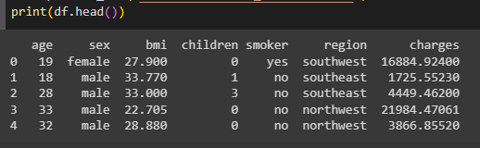
DATA LOADING
In the data preprocessing phase of the Medical Insurance Price Prediction project, the initial step involves loading the dataset using the Pandas library. The dataset, named 'Medical_insurance.csv,' is read into a DataFrame called 'df.' This step ensures that the dataset is accessible for subsequent analysis and model development.

Slide 11
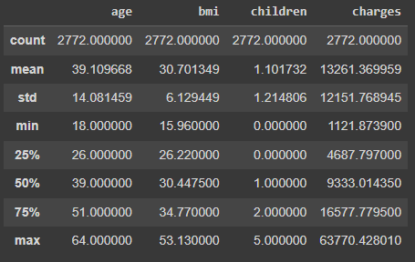
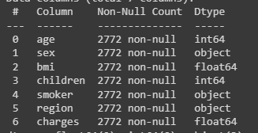
DATA Overview
A comprehensive overview of the dataset is conducted to understand its basic statistics and structure. Descriptive statistics, including mean, standard deviation, and quartiles, are displayed to provide insights into the central tendencies and spread of numerical variables. Simultaneously, the presence of null values is examined, and the data types of each column are reviewed to identify potential inconsistencies.

Slide 12
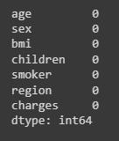
Handling missing values
Prior to any steps, an initial check is performed to identify the presence of missing values in the dataset. This is typically done using functions like isnull() or info() to inspect null values in each column. No missing values are found

Slide 13
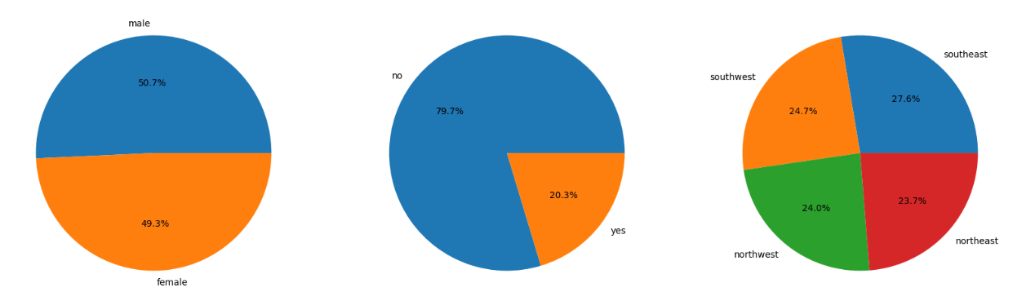
EXPLORATORY DATA ANALYSIS
Exploratory Data Analysis (EDA) is a critical phase in the Medical Insurance Price Prediction Project, serving to unveil insights, patterns, and relationships within the dataset. The EDA process involves various visualization techniques and statistical analyses to better understand the characteristics of the data.
Visualization of categorical variables is done to understand the distribution of categorical variables such as 'sex,' 'smoker,' and 'region.'. Visualization Technique like Pie charts are employed to visually represent the proportion of each category within these variables.

Slide 14
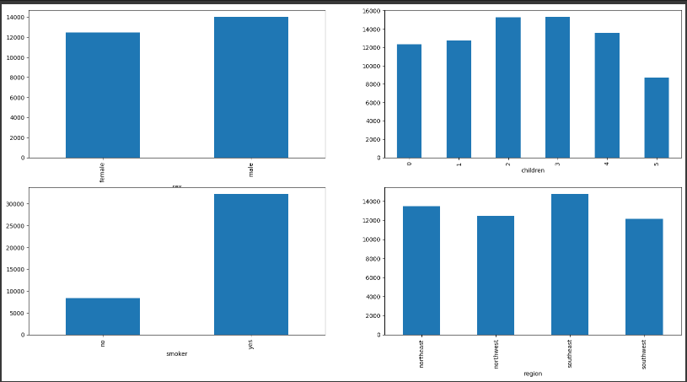
EXPLORATORY DATA ANALYSIS
Analysis of mean insurance charges across categories is done to explore the average insurance charges across different categories such as 'sex,' 'children,' 'smoker,' and 'region.'. Visualization Technique like Bar plots are generated to illustrate the mean insurance charges for each category.

Slide 15
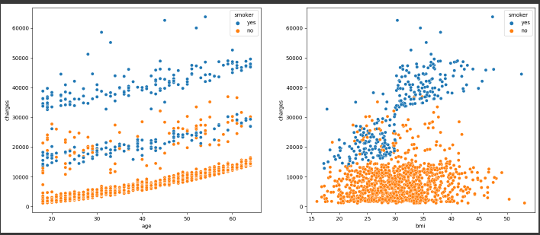
EXPLORATORY DATA ANALYSIS
Scatter Plots for Numerical Features is used to investigate the relationship between numerical features ('age' and 'bmi') and insurance charges, considering the impact of smoking status. Visualization Technique like Scatter plots with hue differentiation based on smoking status are created.

Slide 16
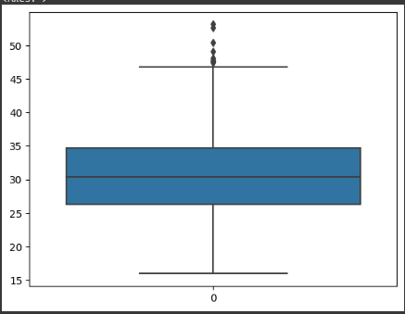
OUTLIER HANDLING
Outlier detection is a crucial step in the data preprocessing phase of the Medical Insurance Price Prediction Project. Outliers, or extreme values, can significantly impact the performance of predictive models, making their identification and handling essential.
Initial Outlier Inspection:
Objective: Identify potential outliers in numerical variables, particularly focusing on 'age' and 'bmi.'
Visualization Technique: Box plots are employed to visually inspect the distribution of these variables and identify potential extreme values.

Slide 17
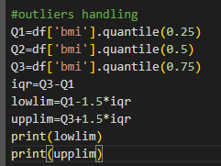
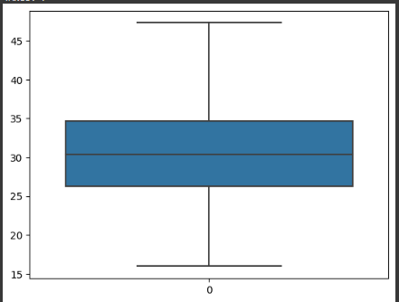
OUTLIER HANDLING
Outlier Handling using Feature Engine:
Objective: Cap extreme values in the 'bmi' variable to mitigate their impact on the analysis.
Library: Feature Engine's ArbitraryOutlierCapper is employed to cap extreme values based on predefined lower and upper limits.
Capping is replacing all higher side values exceeding a certain theoretical maximum or upper control limit (UCL) by the UCL value. Statistical formula for UCL is UCL = Q3 + 1.5 * IQR.

Slide 18
DUPLICATE REMOVAL
Duplicate removal is a crucial step in the data preprocessing phase of the Medical Insurance Price Prediction Project. Identifying and eliminating duplicate records ensures data integrity, preventing biases and inaccuracies in subsequent analyses and model training.
Identification of Duplicate Records:
Objective: Detect and identify duplicate records within the dataset.
Methodology: Utilize Pandas functionality to identify duplicate rows based on all columns.
Elimination of Duplicate Records:
Objective: Remove duplicate records from the dataset.
Methodology: Use the drop_duplicates() function in Pandas to eliminate duplicate rows while retaining the first occurrence.

Slide 19

Feature Engineering
Feature engineering is a critical phase in the data preprocessing of the Medical Insurance Price Prediction Project, involving the transformation and creation of features to enhance the dataset's predictive power and model performance.
Skewness Assessment of Numerical Features:
Objective: Evaluate the skewness of numerical features, such as 'age' and 'bmi.'
Analysis: Skewness provides insights into the distributional shape of the variables.

Slide 20
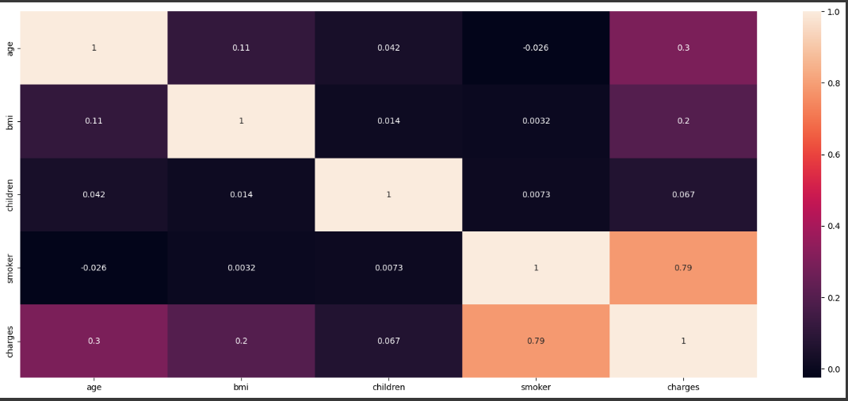
Feature Engineering
Correlation Analysis:
Objective: Explore the relationships among numerical features using a correlation matrix.
Visualization: A heatmap visually represents the correlation coefficients between variables.

Slide 21
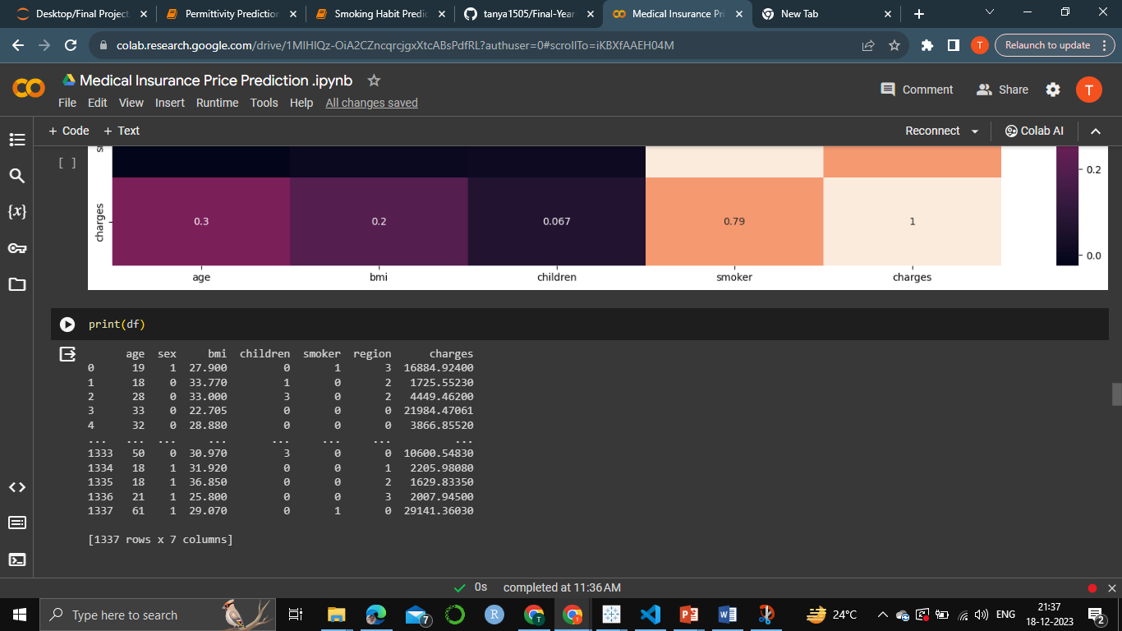
Feature Engineering
Feature Encoding of Categorical Variables:
Objective: Prepare categorical variables, such as 'sex,' 'smoker,' and 'region,' for inclusion in machine learning models.
Encoding Techniques: Map categorical values to numerical representations using techniques like label encoding or one-hot encoding.

Slide 22
Result
In the context of data mining, the Medical Insurance Price Prediction Project demonstrates a comprehensive approach to preprocessing emphasizing the extraction of valuable insights from the dataset.
The project begins with meticulous data cleaning, handling outliers using the Feature Engine library, and removing duplicates to ensure data integrity.
Extensive exploratory data analysis (EDA) employs visualizations and statistical analyses, shedding light on the distribution of categorical variables and relationships between features and insurance charges.
The detection and handling of outliers through quantitative analysis and capping techniques showcase a data-driven approach to enhance model robustness.
The incorporation of feature engineering techniques, such as addressing skewness and encoding categorical variables, reflects a strategic effort to refine feature representation for subsequent modeling.

Slide 23
COURSE CODE: 21BSCS35E06 COURSE TITLE: PREDICTIVE ANALYTICS

Slide 24
contents
Data splitting
Model building
Linear Regression
Random Forest Regression
Gradient Boosting Regressor
XGBoost Regressor
Identify best model
Identify best features
Results
Conclusion

Slide 25
Libraries
from sklearn.linear_model import LinearRegression
from sklearn.ensemble import RandomForestRegressor
from sklearn.ensemble import GradientBoostingRegressor
from xgboost import XGBRegressor
from sklearn.model_selection import train_test_split
from sklearn.model_selection import cross_val_score
from sklearn.metrics import r2_score
from sklearn.model_selection import GridSearchCV

Slide 26
Data splitting
Data splitting is a fundamental step in machine learning and predictive modeling that involves dividing a dataset into two or more subsets for training and evaluation purposes. The primary objective is to assess how well a model trained on one subset generalizes to unseen data.
X=df.drop(['charges'],axis=1)
Y=df[['charges']]
xtrain,xtest,ytrain,ytest=train_test_split(X,Y,test_size=0.2,random_state=i)

Slide 27
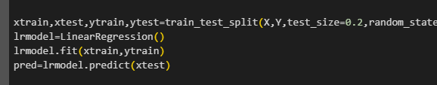
Data Modelling – Linear regression
Description: Linear Regression is a simple and widely-used supervised learning algorithm for predicting a continuous outcome. It assumes a linear relationship between the input features and the target variable. The model computes a linear equation by adjusting coefficients to minimize the difference between predicted and actual values.
Working: The algorithm aims to find the best-fitting line through the data points by minimizing the sum of squared differences (residuals) between predicted and actual values. The coefficients are determined using the least squares method, making the model interpretable and easy to implement.

Slide 28
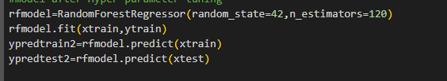
Data Modelling – random forest regression
Description: Random Forest Regression is an ensemble learning method that combines multiple decision tree models to improve predictive performance. Each tree is built on a random subset of the dataset, and predictions are averaged or voted upon for the final result.
Working: Decision trees are constructed based on feature importance, and the random forest aggregates their predictions to reduce overfitting and enhance generalization. It is robust against outliers and can capture complex relationships in the data. Hyperparameter tuning, such as adjusting the number of trees (n_estimators), helps optimize model performance.

Slide 29
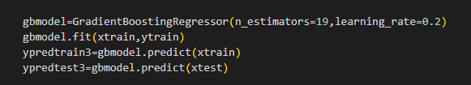
Data Modelling –GRADIENT BOOSTING regression
Description: Gradient Boosting Regression is another ensemble method that builds a series of weak learners (usually decision trees) sequentially, with each tree correcting the errors of its predecessor. It combines their predictions to create a powerful ensemble model.
Working: The algorithm minimizes a loss function by fitting a tree to the residuals of the previous one. This iterative process continues, with each tree addressing the model's weaknesses. Gradient boosting is effective but may require careful tuning to prevent overfitting.

Slide 30
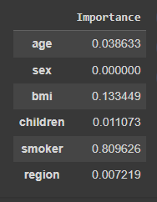
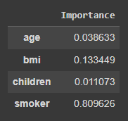
Using Important features to build final model
Important features are identified to build the model using grid.best_estimator_.feature_importances_
The resulting feature importances are then organized into a pandas DataFrame named feats. This DataFrame has two columns: 'Importance' and 'X.columns'. The 'Importance' column contains the calculated importance scores, while the 'X.columns' column corresponds to the feature names from the original dataset.

Slide 31
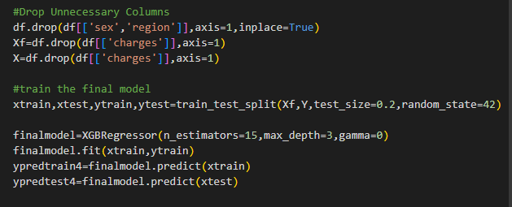
Data Modelling – XGBoost regression
Description: XGBoost (Extreme Gradient Boosting) is an optimized implementation of gradient boosting. It adds regularization terms to control overfitting and incorporates advanced features such as tree pruning and parallel processing.
Working: XGBoost builds trees sequentially, using the gradient of the loss function to guide the tree-building process. Regularization terms penalize complex models, preventing overfitting. Hyperparameters, including the learning rate and tree depth, are crucial for optimal performance. XGBoost is known for its speed, accuracy, and ability to handle diverse datasets.

Slide 32
RESULT
Model | Train Accuracy | Test Accuracy | CV Score
LinearRegression | 0.729 | 0.806 | 0.747
RandomForest | 0.974 | 0.882 | 0.836
GradientBoost | 0.868 | 0.901 | 0.860
XGBoost | 0.870 | 0.904 | 0.860

Slide 33
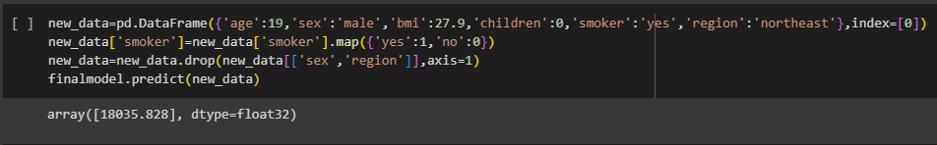
PREDICTION

Slide 34
CONCLUSION
In this project, we successfully developed and fine-tuned regression models, including Random Forest and XGBoost, to predict medical insurance charges with high accuracy.
Through meticulous data exploration, cleaning, and feature analysis, the models showcased robust performance.
The interpretability of feature importance further enhances the models' applicability in understanding key factors influencing insurance costs.
Overall, this project provides valuable insights for insurance providers, contributing to data-driven decision-making in the healthcare insurance domain.

